Slide 1



OPAL Tools
Free Tools for Oracle Software Development
Dietmar Aust Opal-Consulting, Cologne
www.opal-consulting.de
Notes:
I am going to tell you a story of simplicity and robustness.
For the demo use:
- virtual machine, screen resolution: 1600x1200
125% scale mode

Slide 2


About Dietmar
Dipl.-Inform. Dietmar Aust, Freelance Consultant
Master's Degree in Computer Science (MSCS)
Building Oracle based Web Applications since 1997
Portal, Forms, Reports, OWA Toolkit, now APEX!
1997-2000: Consultant at Oracle Germany
Since 09/2000: Freelance Consultant, Since 2006 – APEX only!
Author of the JasperReportsIntegration toolkit
https://github.com/daust/JasperReportsIntegration
2015 Database Developer of the year in the ORDS category
2012-2019

Slide 3
About Dietmar
Since 2008 regular presenter at major Oracle conferences focusing on APEX, ORDS, PDF reporting, various „best practices“ in different areas
For 23 years working with major clients in Germany
Lots of PL/SQL development
Typical team size 1-5 developers sharing code

Slide 4
Why this solution?
Scratch my own itch
Establish standards across teams and clients
Quickstart: Tools can be downloaded and „installed“ immediately
Must be easy to use, flat learning curve
Design goal for tools and procedures:
A person of average intelligence can do it correctly 100% of the time - even on a bad day.

Slide 5
Why this solution?
Tools must be adaptable
Have to support different workflows and development styles
Shared development database vs. Sandboxing
Working from files vs. Working from the database
Filesystem layout must be flexible
Continuous deployment / integration vs. NOTHING

Slide 6
Target audience / use cases
Different tools for different use cases
Liquibase, Flyway, etc.
Requires a lot of infrastructure and advanced skills
Continuous integration, Jenkins, Pipelines, etc.
Our solution
For the average developer / team (has no approach / is unhappy with existing one)
Semi-automatic and well structured approach
Supports the „Oracle“ way of propagating changes through SQL scripts – MINIMUM REQUIREMENT

Slide 7
The Solution
The software:
Written in Java + (generated) batch scripts
Works on Windows, MacOS and Linux
Exporter leverages DBMS_METADATA and SQLcl
Installer leverages SQLcl (binaries already included !)
Tools can be used together … OR separately
Java application opal-export
Java application opal-install
DBMS_METADATA
SQLcl
SQLcl

Slide 8

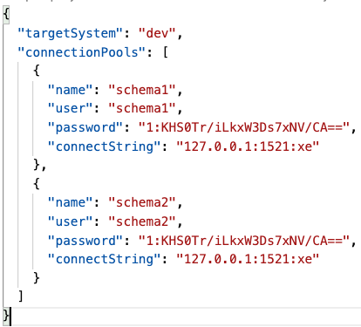
Different Roles: “User“ vs „Process Designer“
Role: „Process designer“
Install / configure for all developers to use
Connection pool files stored locally for each developer
Support for:
Proxy Accounts
Cloud Database

Slide 9
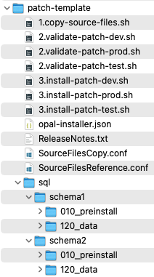
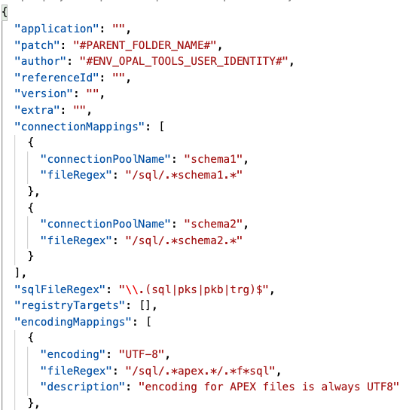
Different Roles: “User“ vs „Process Designer“
Install into git, directories can be chosen very flexibly
Define patch template (e.g. environments dev,test,prod)

Slide 10
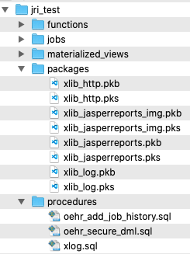

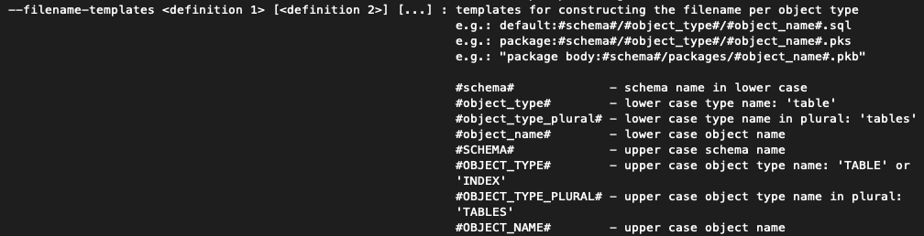
Different Roles: “User“ vs „Process Designer“
Initial export of sources into the filesystem
To have a starting point

Slide 11
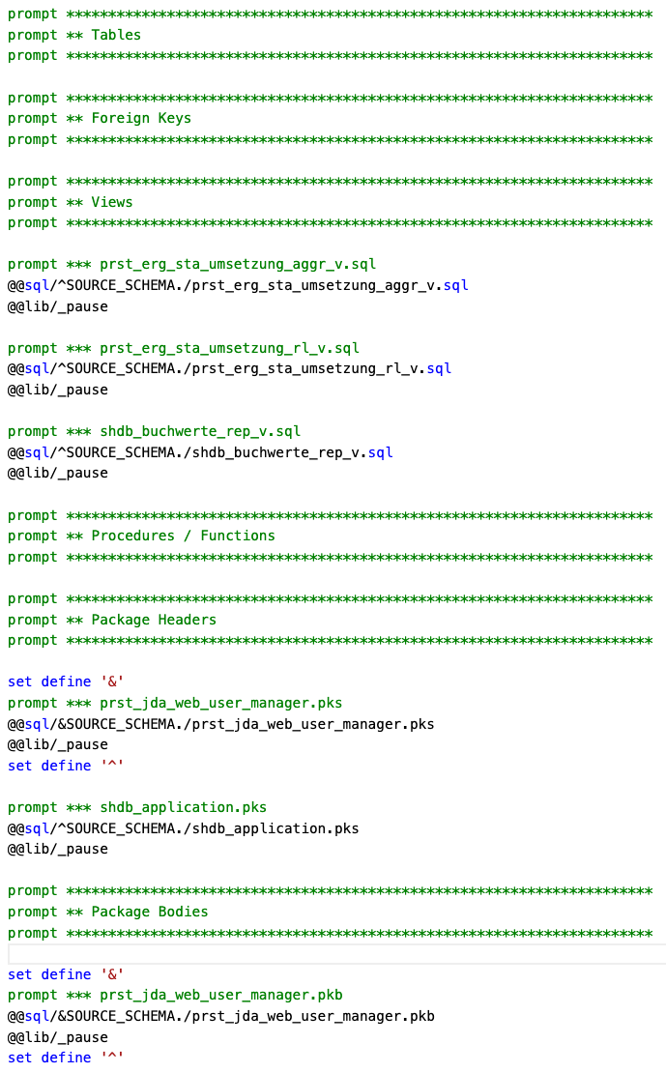
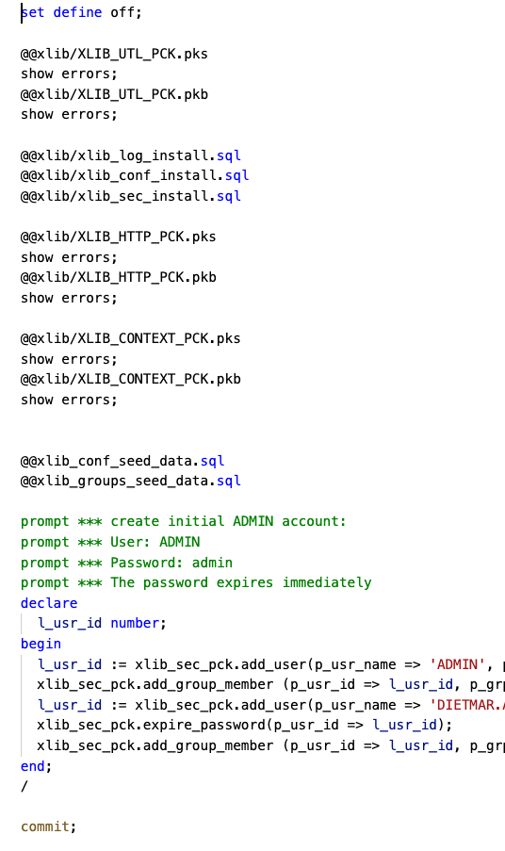
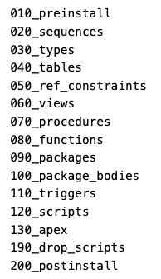

Slide 12
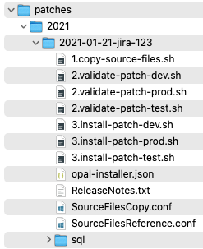
Different Roles: “User“ vs „Process Designer“
Role: „User“ aka the developer team member
Initialize-patch (copies patch template)
=> Create patch along the way … no build process at the end

Slide 13
Different Roles: “User“ vs „Process Designer“
Create patch files (alter table add column …) in the right locations
Register files in SourceFilesCopy.conf or SourceFilesReference.conf
Copy files into target locations if required (directories will be created on demand)
Validate
Install

Slide 14
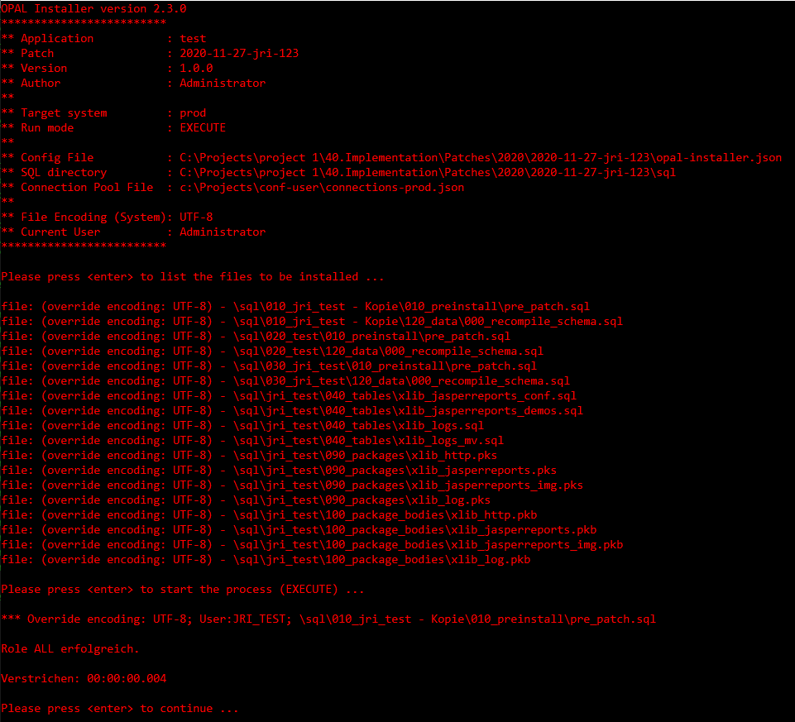
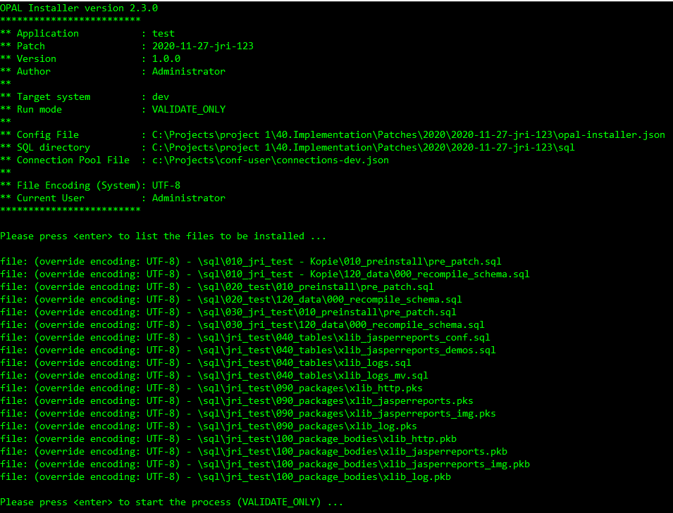
Different Roles: “User“ vs „Process Designer“

Slide 15
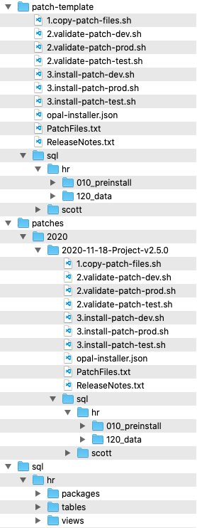

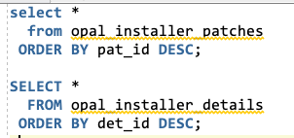
The Solution - INSTALLER
ReleaseNotes.txt
Plain text file
When it exists, will be inserted into patch table

Slide 16

Our Solution
Automatically run sql scripts in the desired order
Don't manually code your release - configure it
Automatic logs (file/database)
Highly configurable
No separate tools, SQLcl embedded (APEXExport, REST export)
Notes:
When you move code changes (APEX, ORDS, PLSQL) from one development to test and production …. What does your strategy feel like?
Are you sure that you have deployed ALL of the changes? And not forgotten anything?
Are you sure that all of the depencies will install in the right order?
Are you sure that there are no compile errors / invalid objects in the end?

Slide 17
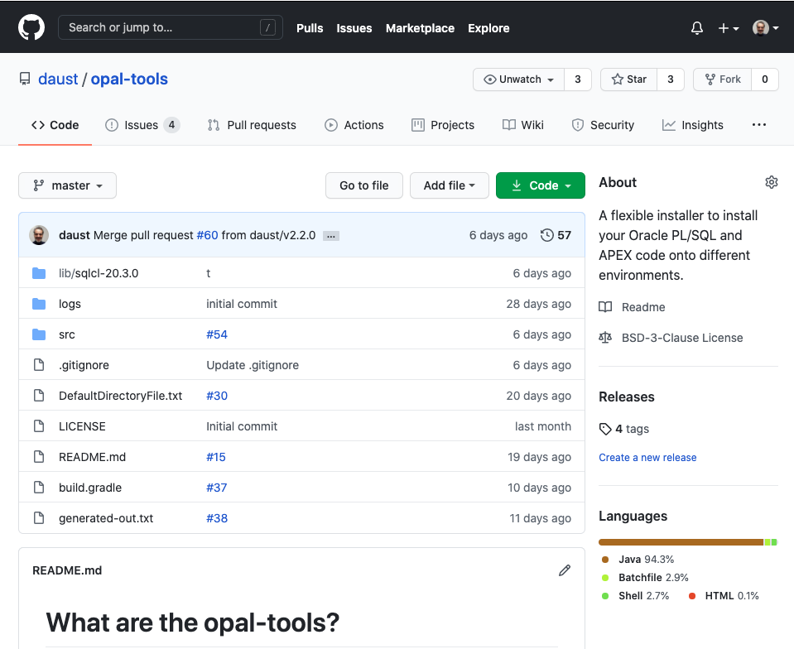
https://github.com/daust/opal-tools

Slide 18
Questions?
Opal Consulting
Email / Website
Zum Tilmeshof 11
50859 Köln
Germany
dietmar.aust@opal-consulting.de
www.opal-consulting.de

Slide 19
MY questions / feature requests
Modularization
DBMS_METADATA.SET_TRANSFORM_PARAM (DBMS_METADATA.SESSION_TRANSFORM, 'EMIT_SCHEMA‘
Should be officially supported
“Bug“ for synonyms referencing a different schema

Slide 20
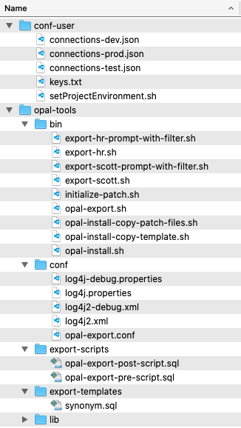
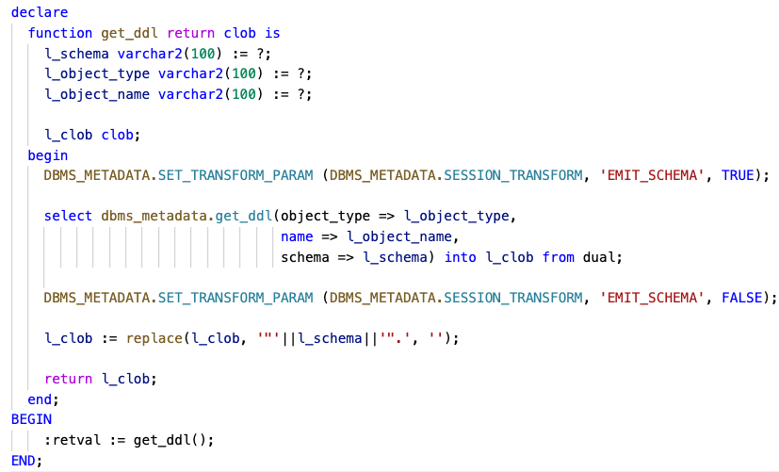
The Solution - EXPORT
Folder „opal-tools/export-templates“
Override the general call to dbms_metadata.get_ddl()

Slide 21
Target audience / use cases
We use incremental patches
Don‘t modify patches that were deployed to TEST

Slide 22
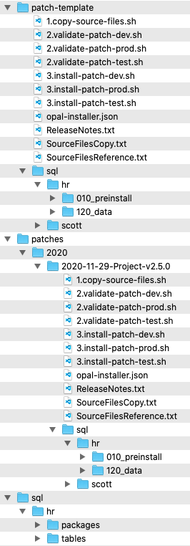
The Solution - INSTALLER
Folder „patch-template“
Will be used as a template for a new patch (copy directory and subdirectories)
Folder „sql“
sql source files
Folder „patches“
<year>/<year-month-day>-<patch name> is generated through the batch script initialize-patch.sh

Slide 23
The Solution - INSTALLER
Iterate through folder tree and execute files
Connection pool is chosen based on regular expression of the file path
Scripts are organized in folders to minimize errors (dependencies / compilation)

Slide 24
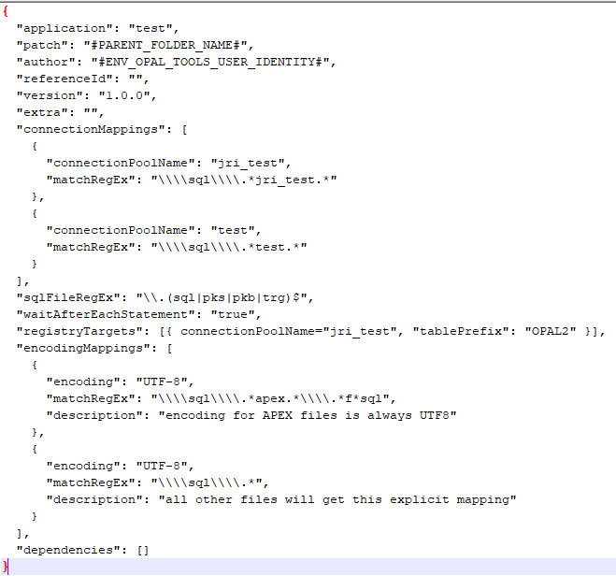
The Solution - INSTALLER
Config file for the patch: opal-installer.json

Slide 25

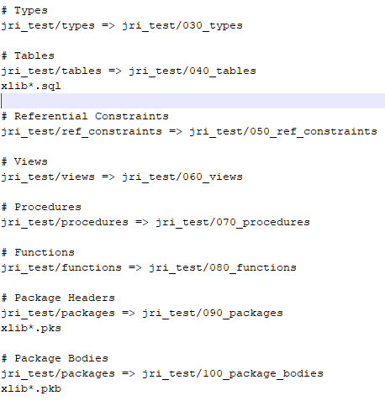
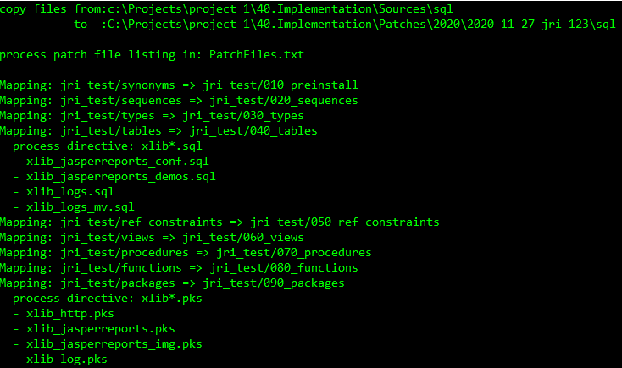
The Solution - INSTALLER
1.copy-source-files.sh
Copies files from the source tree to a target tree

Slide 26
The Solution - INSTALLER
2.validate-<environment>.sh
Validates connection pool and shows files in the order they will be installed

Slide 27
The Solution - INSTALLER
3.install-<environment>.sh

Slide 28

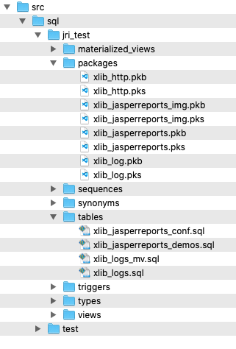
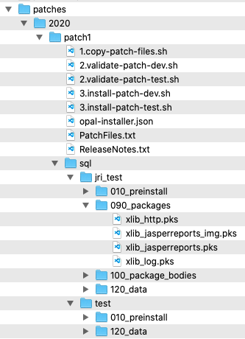
The Solution
Source Files
Patches
install
Test
Export with
DBMS_METADATA
copy files
or
reference files
e.g. @../packages/util.pks
Development
install
Export:
Database Objects
APEX applications
ORDS modules
Custom spool scripts
Patch / Deployment:
SQL scripts
Executed with SQLcl
Production
Patch Installation can be automatically registered

Slide 29
Backup
Notes:
Drag your picture and Send to Back

Slide 30
Demos

Slide 31
Artwork used
IIstudio/Bigstock.com: 391193441
sidarta/Bigstock.com: 266092933

